Slide 1




Sonia Bashash, Creative Director, sonia@numinas.studio
Notes:
📌 Slide 1 – Cover (First Impression)
✅ Big, bold title: “Numinas | High-End Motion & Creative Agency”
✅ Sleek background image or subtle motion graphic preview
✅ Your name, title, website, and contact info

Slide 2




CONFIDENTIAL - DO NOT SHARE AND DUPLICATE
Numinas blends creativity and technology to craft compelling brand stories that evoke emotion, engage audiences, and inspire action.
numinas.studio
Notes:
Slide 2 – What We Do (Value Proposition)
✅ Short, powerful headline:
“We create stunning motion visuals that engage, sell, and inspire.”
✅ 1-2 sentence explanation:
“Numinas helps brands like American Express, Olay, and Air Canada craft high-end motion content for commercials, social media, and digital experiences.”
✅ Key services in bullet points:
Creative Concept & Strategy
2D/3D Animation & Motion Design
Commercial & Social Media Content
Video Editing & Post-Production

Slide 3




CONFIDENTIAL - DO NOT SHARE AND DUPLICATE
We create stunning motion visuals that engage, sell, and inspire.
Numinas helps brands like American Express, Olay, and Air Canada craft high-end motion content for commercials, social media, and digital experiences.
Services:
Creative Concept, Strategy, and Copywriting
Audio and Video Editing & Post-Production
Explainer Videos & Branded Storytelling
Show Packages & Broadcast Design
Commercials, Ads & Social Media Content
2D/3D Animation & Motion Design
numinas.studio
Notes:
Slide 2 – What We Do (Value Proposition)
✅ Short, powerful headline:
“We create stunning motion visuals that engage, sell, and inspire.”
✅ 1-2 sentence explanation:
“Numinas helps brands like American Express, Olay, and Air Canada craft high-end motion content for commercials, social media, and digital experiences.”
✅ Key services in bullet points:
Creative Concept & Strategy
2D/3D Animation & Motion Design
Commercial & Social Media Content
Video Editing & Post-Production

Slide 4
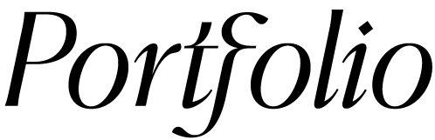


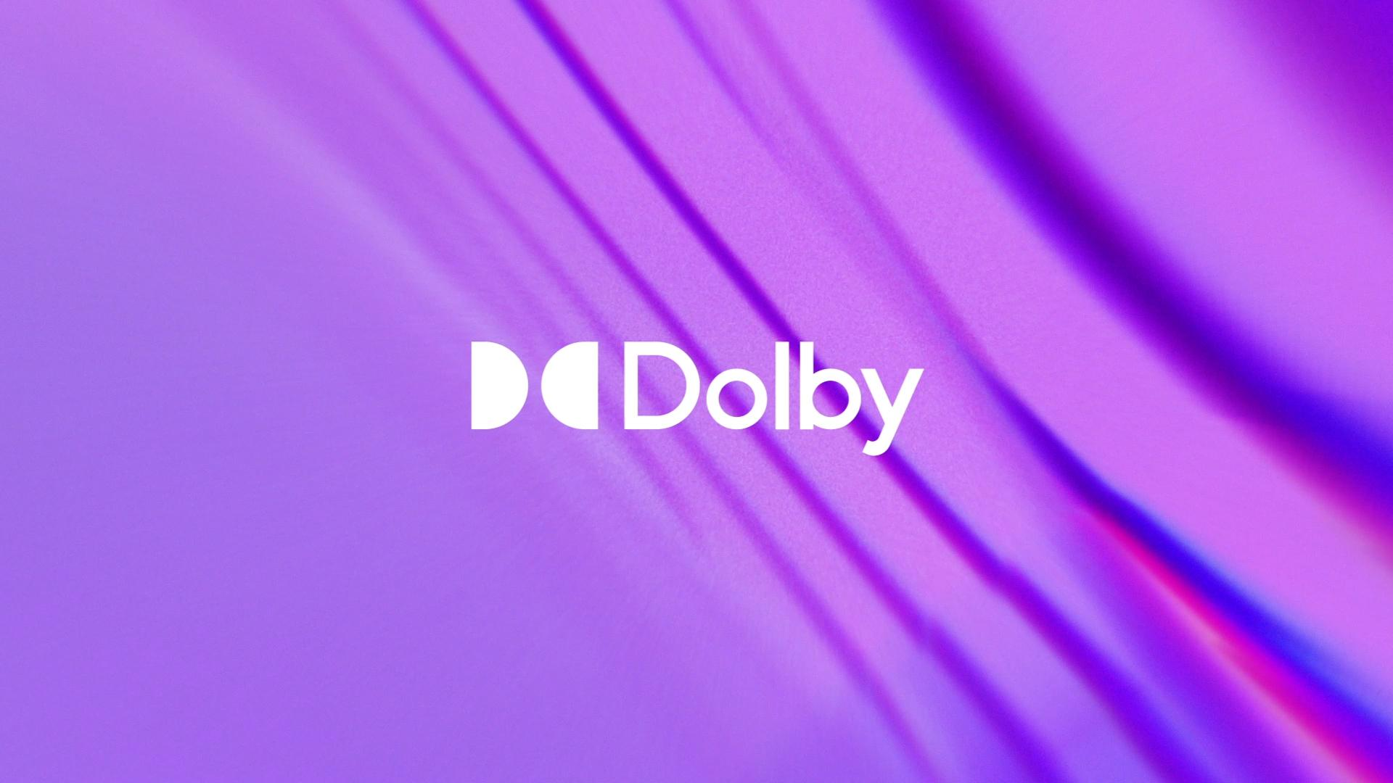
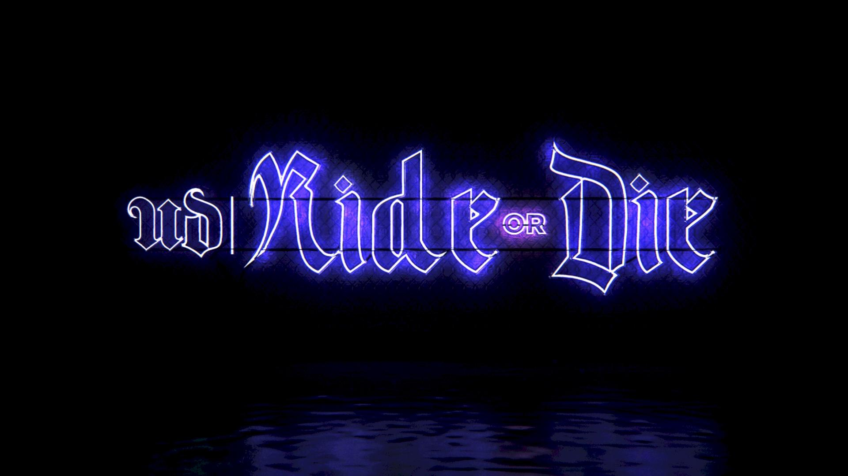

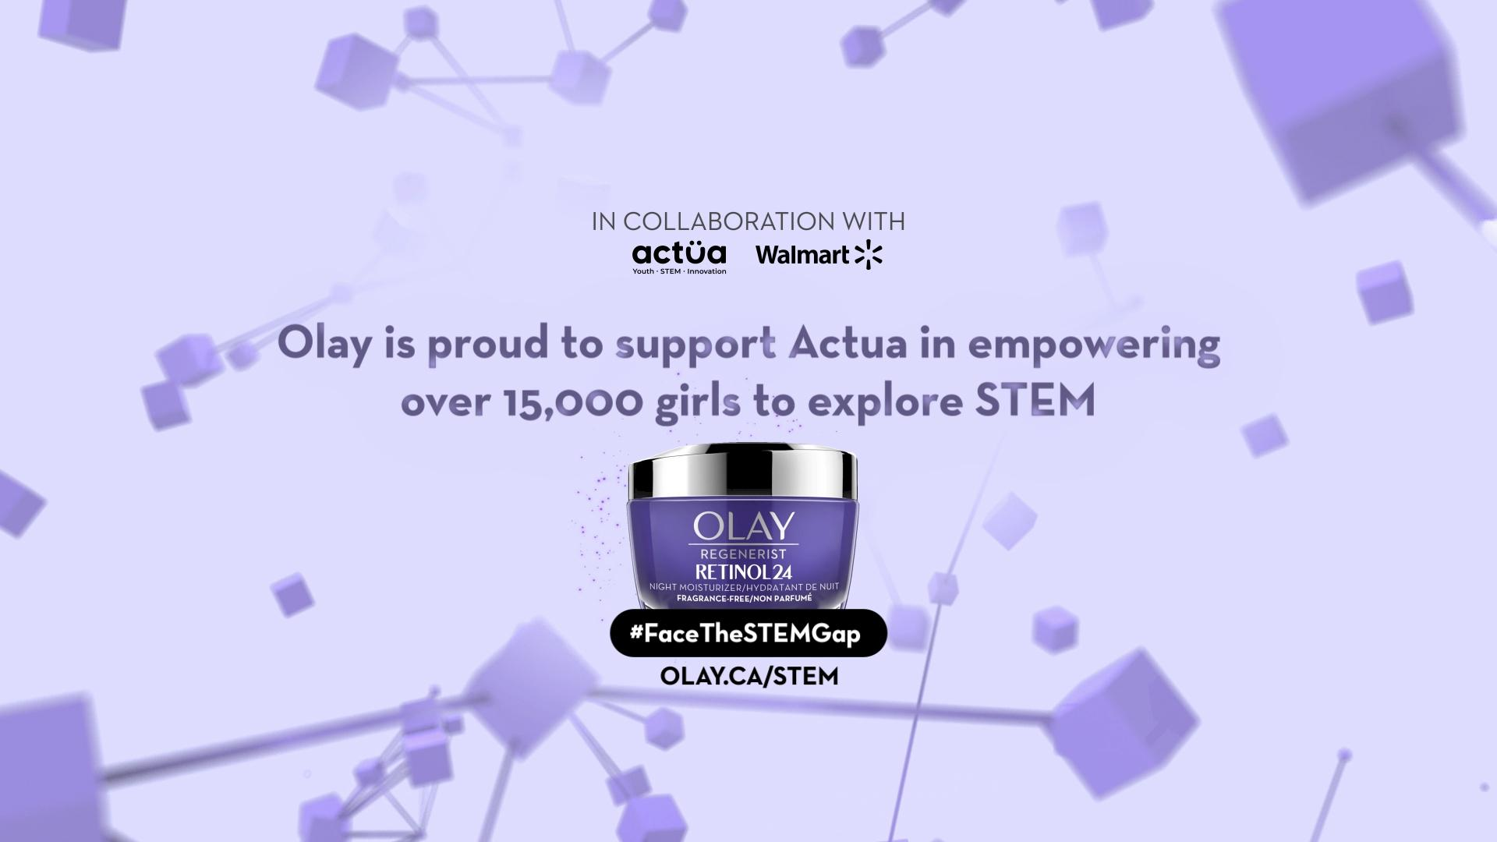
CONFIDENTIAL - DO NOT SHARE AND DUPLICATE
A collection of projects we had the opportunity to bring to life through design, animation, and storytelling.
Click on project names to view their videos.
Secret
American Express
Dolby
Urban Decay
BELLEMINT
Olay
numinas.studio
Notes:
📌 Slide 3 – Portfolio Showcase (Best Work First)
🎬 Our Work in Action
(Include 3-5 of your best projects. Each should have a short, powerful caption.)
▶ American Express – Elegant motion graphics for a high-impact campaign.
▶ Urban Decay – Immersive visuals for a luxury product launch.
▶ Olay & Secret – Emotionally-driven storytelling through sleek motion design.
🔗 [Link to full portfolio or showreel]

Slide 5






CONFIDENTIAL - DO NOT SHARE AND DUPLICATE
Discovery & Strategy
Understanding your brand’s vision & goals.
Copywriting & Scripting
Crafting compelling scripts that drive engagement.
Final touch & Delivery
Sound design, color correction, and flawless execution.
Concept & Storyboarding
Developing visual direction and narrative flow.
Production & Animation
Bringing your story to life with stunning motion design.
numinas.studio
Notes:
📌 Slide 4 – How We Work (Process)
A Seamless Creative Process, Designed for Excellence.
1️⃣ Discovery & Strategy – Understanding your brand’s vision & goals.
2️⃣ Concept & Storyboarding – Developing compelling narratives & visual direction.
3️⃣ Production & Animation – Bringing your story to life through high-end motion design.
4️⃣ Final Touch & Delivery – Flawless execution & maximum impact.
💡 From concept to final frame, we handle everything—so you can focus on your brand’s success.

Slide 6

CONFIDENTIAL - DO NOT SHARE AND DUPLICATE
Emotion-Driven Storytelling
We don’t just create visuals; we create experiences.
Premium Aesthetic & Execution
High-end motion design that elevates your brand.
End-to-End Creative Solutions
From concept to final delivery, we handle it all.
Industry-Leading Expertise
With over a decade of experience, we bring strategic insight and creative excellence to every project.
Trusted by Top Brands & Leading Agencies
Collaborations with American Express, Olay, Secret, Air Canada, Urban Decay, and creative agencies.
At Numinas, we don’t just create visuals—we craft immersive experiences that connect, inspire, and leave a lasting impact. Our expertise in motion design, storytelling, and innovation allows us to transform ideas into stunning, high-performance content that resonates with audiences.
numinas.studio
Notes:
Slide 2 – What We Do (Value Proposition)
✅ Short, powerful headline:
“We create stunning motion visuals that engage, sell, and inspire.”
✅ 1-2 sentence explanation:
“Numinas helps brands like American Express, Olay, and Air Canada craft high-end motion content for commercials, social media, and digital experiences.”
✅ Key services in bullet points:
Creative Concept & Strategy
2D/3D Animation & Motion Design
Commercial & Social Media Content
Video Editing & Post-Production

Slide 7


CONFIDENTIAL - DO NOT SHARE AND DUPLICATE
numinas.studio/Explainervideos
Sonia Bashash, Creative Director, sonia@numinas.studio
Notes:
📌 Slide 7 – Call to Action (Next Steps)
Let’s Build Stunning Visual Stories for Your Brand.
📅 Let’s talk: Schedule a quick call to explore how Numinas can elevate your brand’s visual storytelling.
🔗 [Insert Calendly or Booking Link]
📧 [Your Email] | 🌐 [Your Website] | 📞 [Your Contact Info]
✨ Beautifully designed. Emotionally powerful. Uniquely yours. ✨

